Slide 1
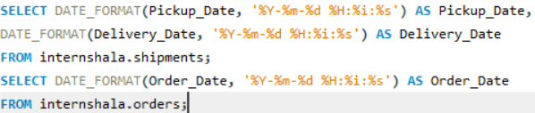
Task 1: Data Cleaning & Preparation
VIDEO LINK: https://drive.google.com/file/d/1bUcTm4tl6kOdAvBX0ujmZt2jdV3wspZO/view?usp=sharing
There was no duplicate values detected in Order_ID or Shipment_ID records.
There was no missing or null values in Delay_Hours in the Shipments Table.
Converting all date columns (Order_Date, Pickup_Date, Delivery_Date) into YYYY-MM-DD HH:MM:SS format using SQL date functions as given below.

Slide 2


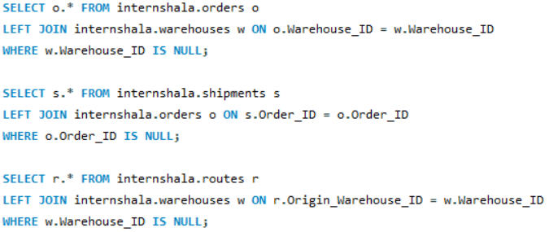
Validated referential integrity between Orders, Routes, Warehouses, and Shipments.

Slide 3
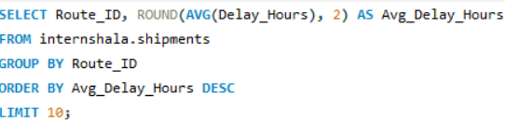
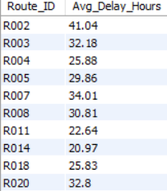
Task 2: Delivery Delay Analysis
Calculated delivery delay (in hours) for each shipment like Delivery_Date – Pickup_Date are already inserted into table.
Top 10 delayed routes based on average delay hours.

Slide 4
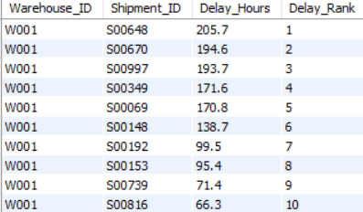
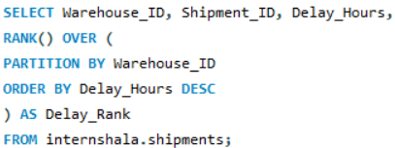
Using SQL window functions to rank shipments by delay within each Warehouse_ID as given below.
Identifying the average delay per Delivery_Type (Express / Standard) to compare service-level efficiency as given below.

Slide 5
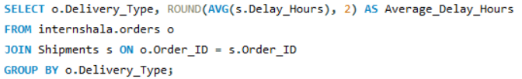


Slide 6
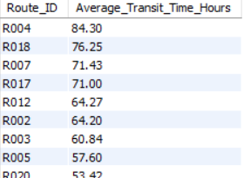
Task 3: Route Optimization Insights
Average transit time (in hours) across all shipments.

Slide 7
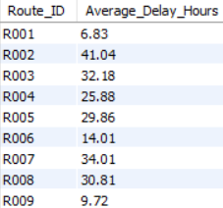
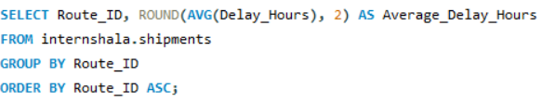

Average delay (in hours) per route.
Distance-to-time efficiency ratio = Distance_KM / Avg_Transit_Time_Hours.

Slide 8
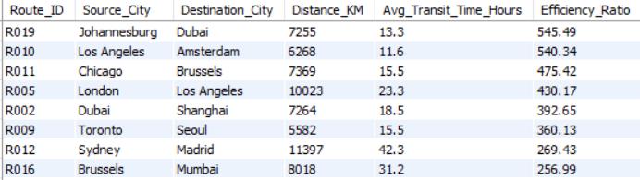
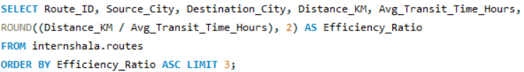

- Identifying 3 routes with the worst efficiency ratio (lowest distance-to-time) as given below.

Slide 9
Recommending potential routes or hub pairs for optimization.
Hub Testing: Conduct a deep-dive testing of the Tokyo and Chicago warehouses to identify if the bottlenecks are due to labor shortages, outdated sorting technology, or capacity constraints.
Route Rerouting: For Route R009, consider temporary rerouting through a high-performing secondary hub (e.g., Amsterdam or Memphis) until the primary cause of the 0% reliability is resolved.
Agent Reassignment: Cross-reference these routes with the "Low Performance Agents" list. High-volume, low-performance routes should be prioritized for assignment to senior or higher-rated delivery agents.

Slide 10
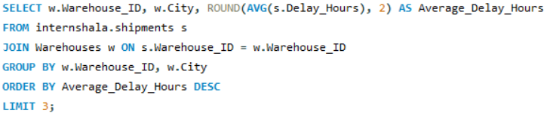

Task 4: Warehouse Performance
Finding the top 3 warehouses with the highest average delay in shipments dispatched as given below.
Calculating total shipments vs delayed shipments for each warehouse given below

Slide 11
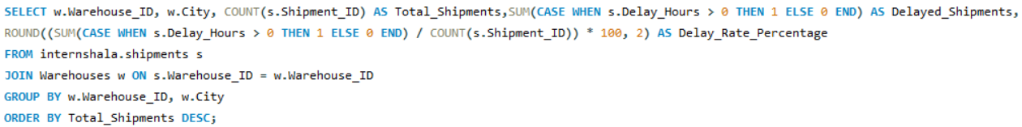
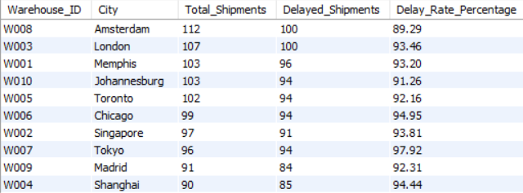

Slide 12
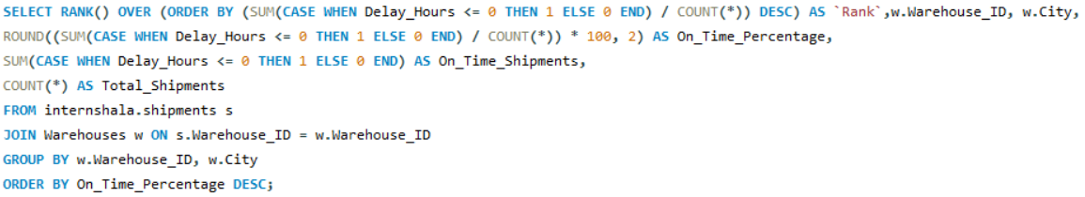
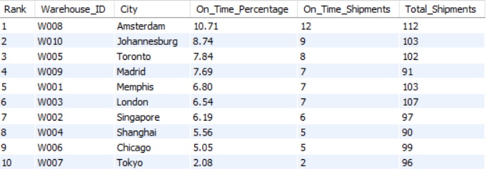
Ranking all warehouses based on on-time delivery percentage as given below.

Slide 13
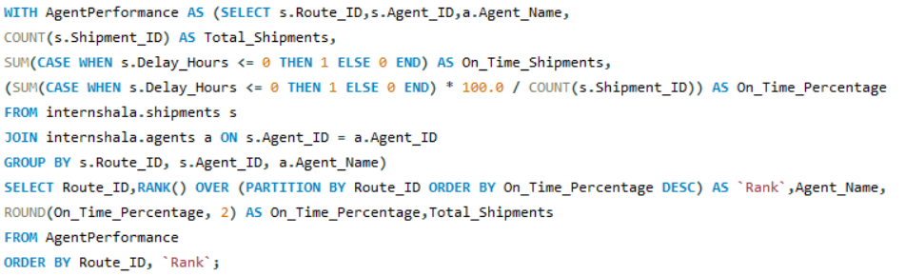
Task 5: Delivery Agent Performance
Ranking delivery agents (per route) by on-time delivery percentage.

Slide 14
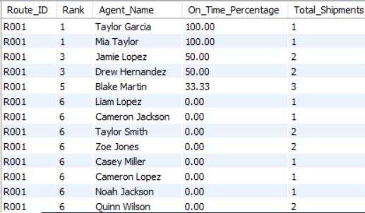
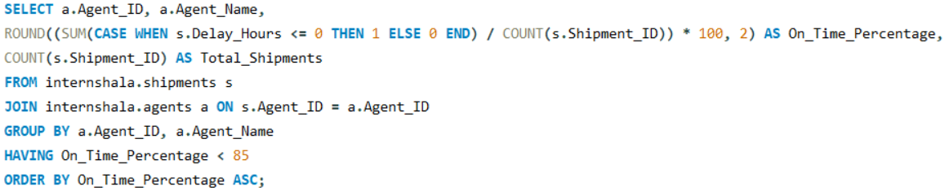
Finding agents whose on-time % is below 85% as given below.

Slide 15
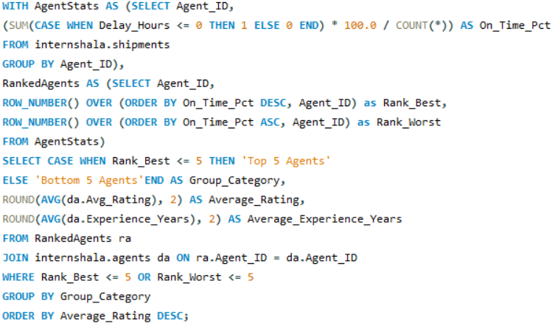

Comparing the average rating and experience (in years) of the top 5 vs bottom 5 agents using subqueries.

Slide 16
Workload balancing strategies for low-performing agents based on insights.
1. Strategic Focus: Process Over People
Since more experience doesn't lead to faster deliveries and workload isn't the issue, traditional training and load balancing will fail.
Strategy: Shift focus from "fixing agents" to "fixing the pipeline." The universal delays suggest agents are likely receiving packages late from the warehouse.
2. Re-Evaluate "Seniority" Assignments
The data suggests that most experienced agents (who are currently your slowest) might be assigned the most complex or "impossible" routes (like R002 or R004 identified earlier).
Strategy: Rotate routes. Do not penalize senior agents for delays if they are permanently assigned to historically bottlenecked routes.
.
3. Technology Enablement vs. Skills Training
Since years of experience don't improve speed, the barrier is likely navigational or operational.
Strategy: Instead of generic "delivery skills" training, implement Dynamic Route Optimization software.

Slide 17
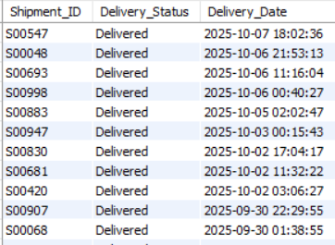
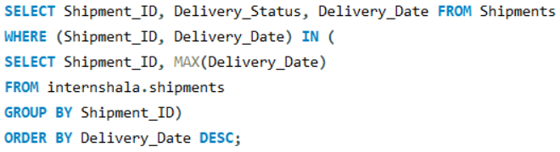
Task 6: Shipment Tracking Analytics
For each shipment, displaying the latest status (Delivered, In Transit, or Returned) along with the latest Delivery_Date.

Slide 18
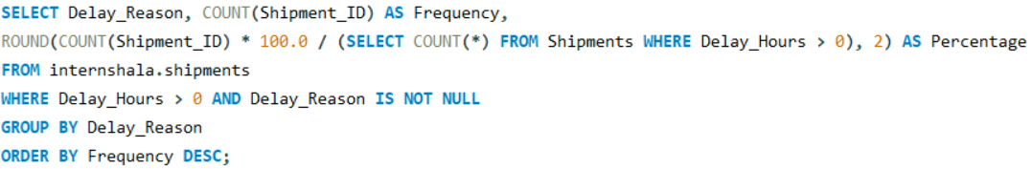

Finding the most frequent delay reasons (if available in delay-related columns or flags).

Slide 19
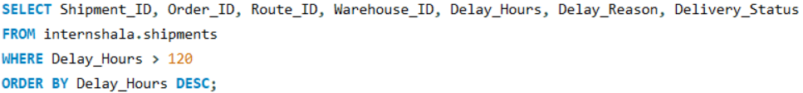
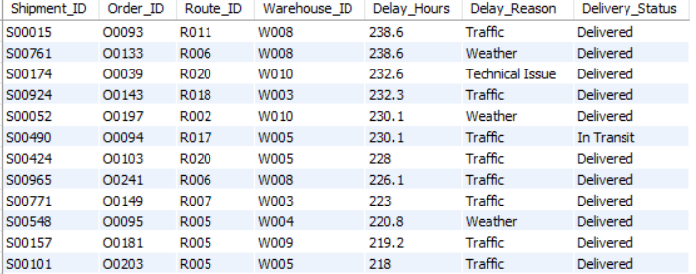
Identifying orders with exceptionally high delay (>120 hours) to investigate potential bottlenecks as given below

Slide 20
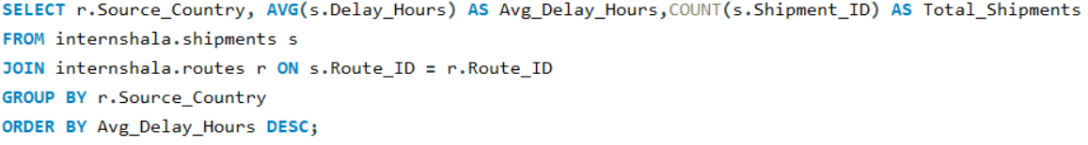
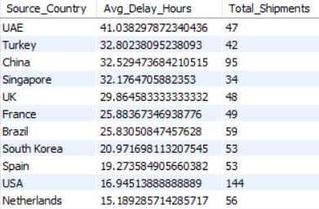
Task 7: Advanced KPI Reporting
Average Delivery Delay per Source_Country

Slide 21

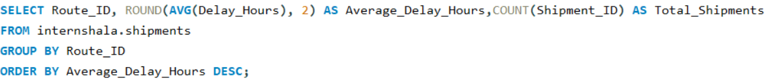
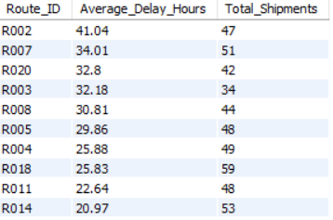
On-Time Delivery % = (Total On-Time Deliveries / Total Deliveries) * 100.
Average Delay (in hours) per Route_ID

Slide 22
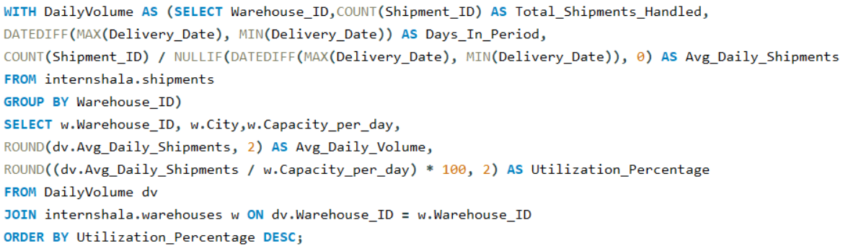
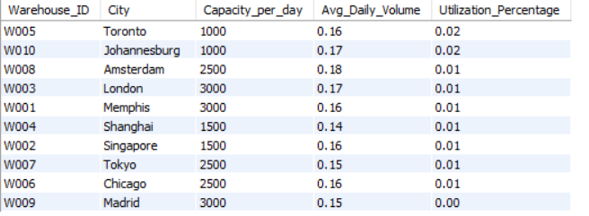
Warehouse Utilization % = (Shipments_Handled / Capacity_per_day) * 100

Slide 23
Key Operational Insights in FedEx
1. Hub & Warehouse Bottlenecks:-
Critical Failure Points: Tokyo (W007) and Chicago (W006) are the primary bottlenecks. Tokyo’s 2.08% OTD rate suggests a systemic failure in either customs processing or local sorting capacity.
High-Volume Stress: Major hubs like London and Singapore are also struggling (under 7% OTD), indicating that high-volume processing is currently exceeding operational capacity.
2. High-Risk Route Pairs:-
Total Reliability Failure: Route R009 is currently operating at 0% on-time efficiency. Any shipments assigned to this route are guaranteed to be delayed, representing a major risk to customer satisfaction.
Strategic Bottlenecks: Route R018 (high volume, 2.94% OTD) is a "critical path" that handles a large portion of the network's load but fails consistently.
3. Extreme Delays (>120 Hours):-
A significant portion of delays exceed the 5-day mark, which typically points to regulatory/customs holds or shipment misrouting rather than simple transit slowness

Slide 24
Strategic Business Recommendations for FedEx
Reroute Priority Freight: Immediately divert high-priority shipments away from Route R009 and R012. Use high-performing alternate hubs (e.g., Memphis or Amsterdam) even if it increases mileage, to restore reliability.
Tokyo Process: Deploy a rapid-response team to the Tokyo (W007) hub to identify if the 2.08% OTD is caused by staffing shortages, equipment failure, or a specific customs documentation bottleneck.
Update Customer SLAs: Temporarily adjust "Expected Delivery Dates" for routes originating from or passing through Tokyo and Chicago to reflect the current 120+ hour delay reality.

